Slide 1
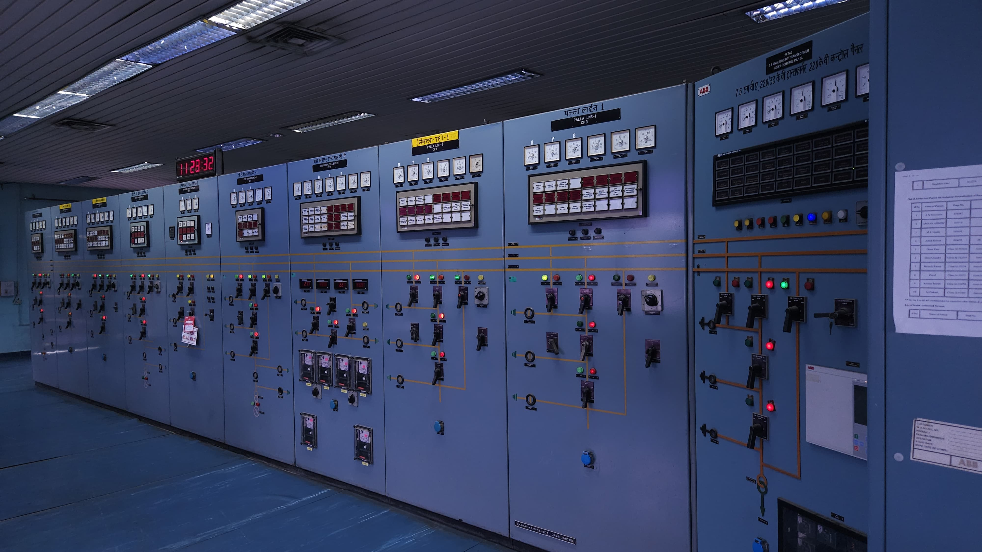

Relay Panels

Slide 2
Introduction
Any fault (like short circuit, overload, or earth fault) can cause serious damage.
Relays quickly detect abnormal conditions and send signals to trip circuit breakers, isolating the faulty section.
It protects, monitors, and controls equipment (like Transformer & Generator) , and isolates faults.
It helps keep the system safe, reliable, and working properly.
Relay connects field devices like CTs/PTs to circuit breakers.

Slide 3
Data Flow
Relay
Field Devices
Trip Signal
Relay Panel
Sensing : Field Devices
Circuit Breaker Action
1. CT : Measures current
2. PT : Measures voltage
Send this analog signals to Relays inside the RP.
If a fault is detected Relay sends a trip signal (24V) to CB trip Coil.
RTU
CB receives the trip command from the relay.
CB opens to disconnect faulty section and protect equipment.
CB sends Status Feedback to SCADA via RP
SCADA
Monitoring & Control

Slide 4
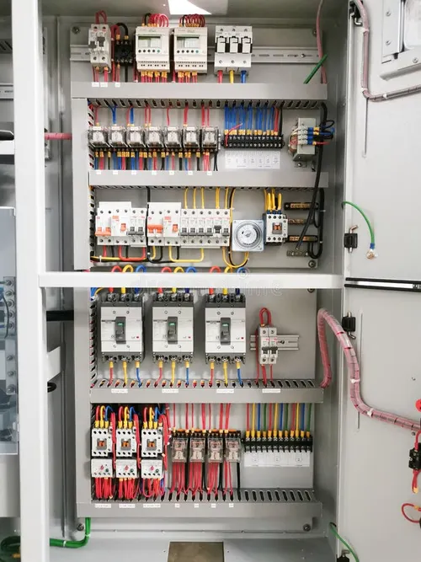
Relay Panel
RP (Relay Panel) is a metal cabinet/panel that contains many electrical devices like relays, meters, switches, etc.
Relay is one of the key components mounted inside the CRP.
Some of basic Relay and their usage in protection purpose are:

Slide 5
Component | Function
Protective Relays | Detect electrical faults and send trip signal to cb
Trip & Close Coils | Execute opening/closing of circuit breaker
Push Buttons | Manual trip/close operation
Indicating Lamps | Show breaker status (open/close/fault)
Meters (V, A, Hz) | Monitor electrical quantities
Auxiliary Relays | Support control logic
Terminal Blocks | For wiring connections
Wiring Harness | Routes all signal cables
Annunciator Panel | Shows alarm and fault indications
SCADA Interface | Sends data to remote control center

Slide 6
Types of Relay panel
Control Relay Panel
Generator Relay Panel
Control and protects Switchyard Equipment.
Used for Transformers, feeders, lines, busbars, etc.
Location – Switchyard Control Room
Trip/Close of circuit breakers in the grid system.
Control and protects Generators.
Used for Generating units (thermal, gas, hydro, etc.)
Location - Generator Control Room.
Trip/Close of generator breakers and synchronizing.

Slide 7
Control Relay Panel (Types)
Transformer Relay Panel – It is a type of CRP that monitors, protects, and controls a power transformer in a substation or power plant.
Feeder Relay Panel – It is a type of CRP used to protect and control an outgoing or incoming feeder line in a power distribution or transmission system.
Line Relay Panel - It is a CRP that provides distance and overcurrent protection to high-voltage transmission lines in substations.
Busbar Relay Panel - It is a CRP used for protecting busbars by detecting internal faults and isolating the faulty section using differential protection.

Slide 8
Relay Name | Function
Differential Relay | Detects internal winding faults by comparing input and output current (primary ≠ secondary)
Restricted Earth Fault | Detects earth faults close to the neutral or inside the transformer zone
Overcurrent Relay | Protects against short-circuit or overload beyond threshold
Earth Fault Relay | Detects ground faults in transformer secondary side
Buchholz Relay | Gas accumulation or oil surge in transformer tank
Winding Temperature Relay | Trips transformer if winding temperature exceeds safe limits
Oil Temperature Relay | Trips transformer if oil temperature crosses threshold
Overvoltage Relay | Detects dangerous overvoltage conditions
Master Trip Relay | Initiates lockout of the transformer bay after critical fault
Trip Circuit Supervision Relay | Ensures continuity and health of trip coil circuits
DC Fail Relay | Monitors health of DC supply used by protection relays

Slide 9
RTU - SCADA
RTU (Remote Terminal Unit) collects real-time data from relays and breaker status inside the CRP, and sends it to SCADA or control centers.
Usually, there is one RTU for each CRP or GRP.
All RTUs across the plant are connected to the Central Control Room or SCADA server.
SCADA is a computer-based control system used to monitor and control power plants, substations, water treatment, etc.
SCADA processes this data and displays it via the HMI for real-time monitoring and control.

Slide 10
Some Software of SCADA
Event Logger :
Records time-stamped digital events like breaker operations, system alarms, and control actions. Essential for post-event diagnostics and sequence-of-events analysis.
2. CMS (Condition Monitoring System) :
Monitors the health of major substation assets such as transformers and circuit breakers by tracking parameters like temperature, vibration, and gas content. Enables predictive maintenance and reduces downtime.
3. GPS Clock :
Provides a precise and synchronized time source to all connected substation devices

Slide 11
Some Software of SCADA
4. ABT Meter (Availability-Based Tariff Meter):
Used for energy accounting and tariff calculation as per the ABT mechanism. Measures parameters like active/reactive energy, frequency, and demand for grid discipline and billing.
5. HMI (Human Machine Interface) :
Provides a graphical interface for operators to monitor and control substation equipment. Displays real-time data, alarm indications, control switches, and historical trends.
6. PMU (Phasor Measurement Unit) :
Installed for wide-area monitoring using Synchro phasors .
Measures frequency deviation, voltage angle difference — crucial for maintaining synchronism with the grid.

Slide 12
Special Thanks :
1. S.S Narula Sir
2. Kaushal Sir
3. Rajesh Sir
Thank You

